Slide 1
Introduction to psychology
By
Dr. Muhammad Awais

Slide 2
Psychology
Psychology is the scientific study of behavior and mental process
A person who study the psychology known as psychologist
Psychologist study:
Overt or observable behavior
The word ‘overt’ can be defined as something that is plainly apparent and openly displayed. The term overt behavior means just that. The observable behaviors such as walking, talking, laughing, which can be seen readily are categorized as overt behavior.

Slide 3
Psychology
Covert behavior
private mental processes that cannot be directly observed or measured and must be inferred from overt behavior
The opinions of behaviorists and psychologists in the matter have always been divergent. Here, we are going to discuss about Covert behavior
For instance, thinking, reasoning, reading in silent are covert behaviors

Slide 4
Behavior
Behavior is any action an organism uses to adjust to the environment. But, there has always been divergent opinions about what ought to be included under the category of behavior. In the narrower sense, only behaviors or actions that can be sensed or are visible are categorized as behaviors.

Slide 5
Primary goals of psychology
Describe behavior: what is the nature of this behavior
Understand and explain behavior: why does it occur
Predict behavior: can we forecast when and under what circumstance it will occur?
Control behavior: what factors influence this behavior

Slide 6
Types of psychologist
Cognitive psychologist: study the ways humans perceive and understand the world around them
Physiological psychologist: study the role of brain function in behavior
Developmental psychologists: study how individuals grow and change throughout their lives

Slide 7
Conti…
Social psychologist: study how people influence and are influenced by others
School psychologist: test and evaluate, analyze learning problem, counsel teachers and parents
Industrial/ Organizational psychol0gist: work on a wide variety of issues in work settings

Slide 8
Conti….
Forensic psychologist: work on behavioral issues in the legal, judicial and correctional systems
Health psychologist: focus on ways to improve health by altering behavior
Sports psychologists: study how psychological factors influence performance in sports, physical activity and exercise

Slide 9
Areas of psychologist
Clinical psychologist: is the diagnosis and treatment of mental and behavioral disorder
Counseling psychology: typically involves working with people who have less severe social, emotional and vocational problems

Slide 10
School of thoughts in psychology
Structuralism
Functionalism
Psychoanalysis
Behaviorism
Gestalt psychology
Humanistic psychology
Positive psychology
Cognitive
Evolutionary

Slide 11
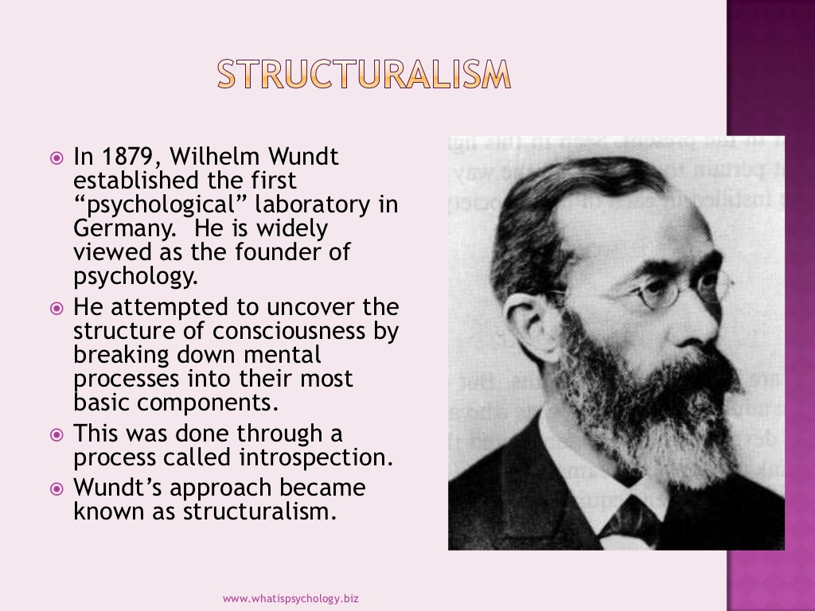

Slide 12
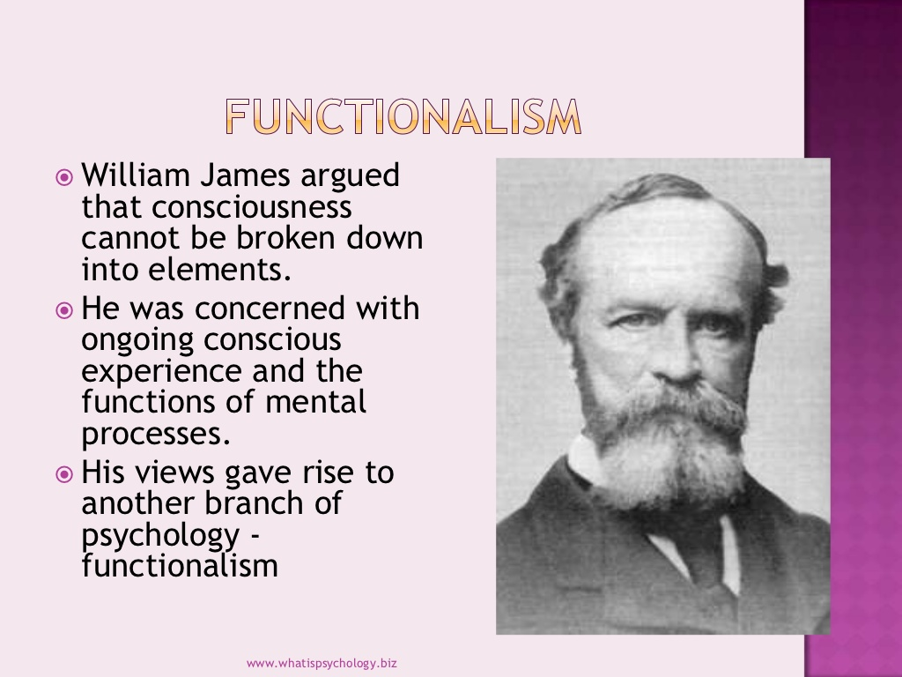

Slide 13
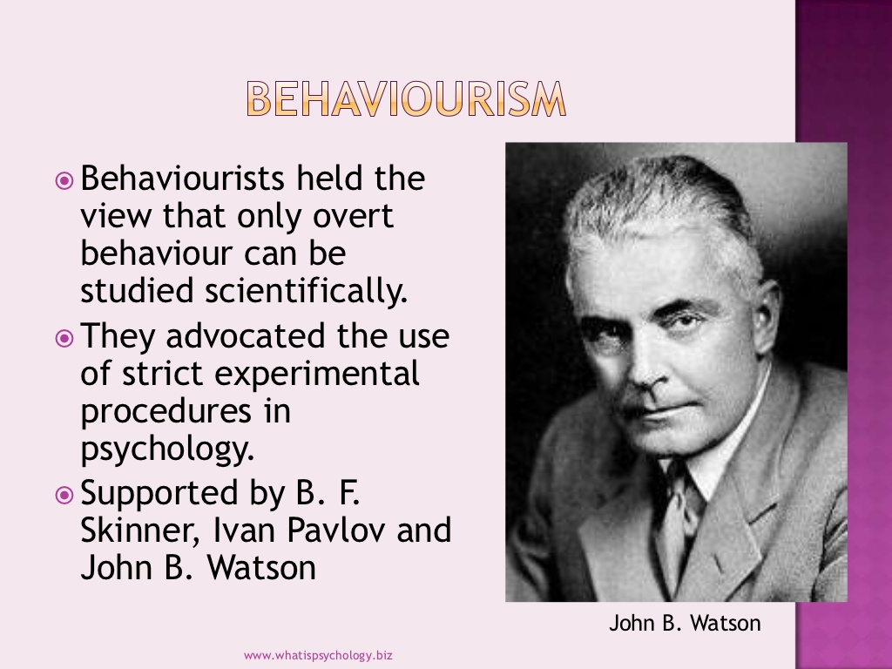

Slide 14
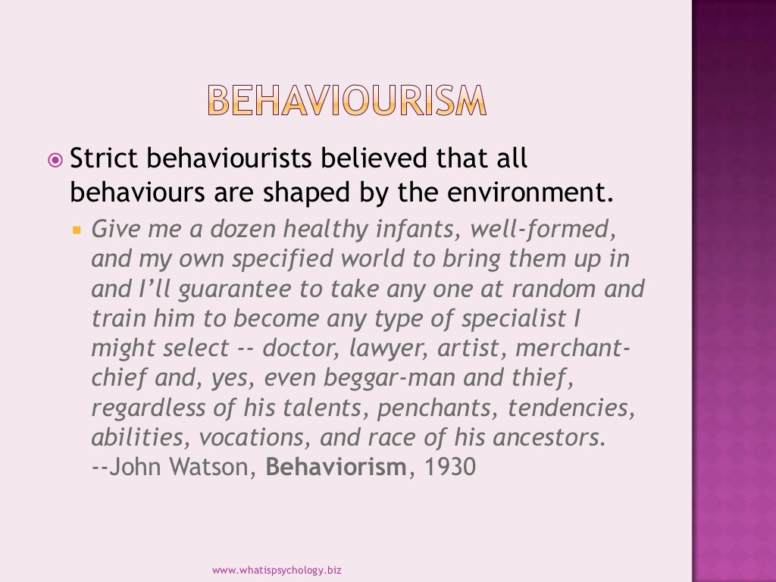

Slide 15
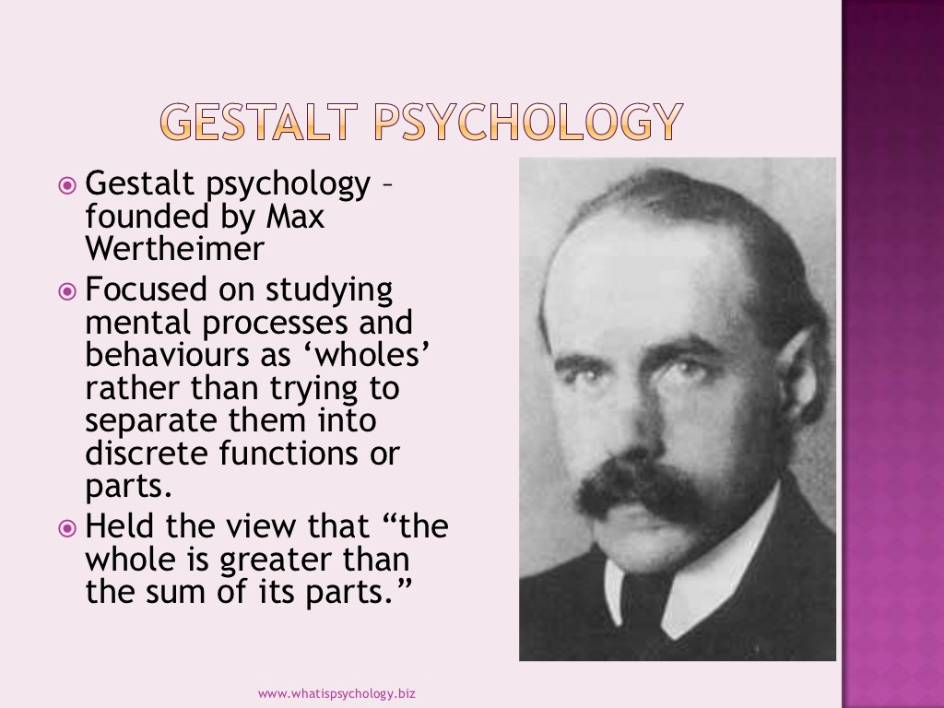

Slide 16
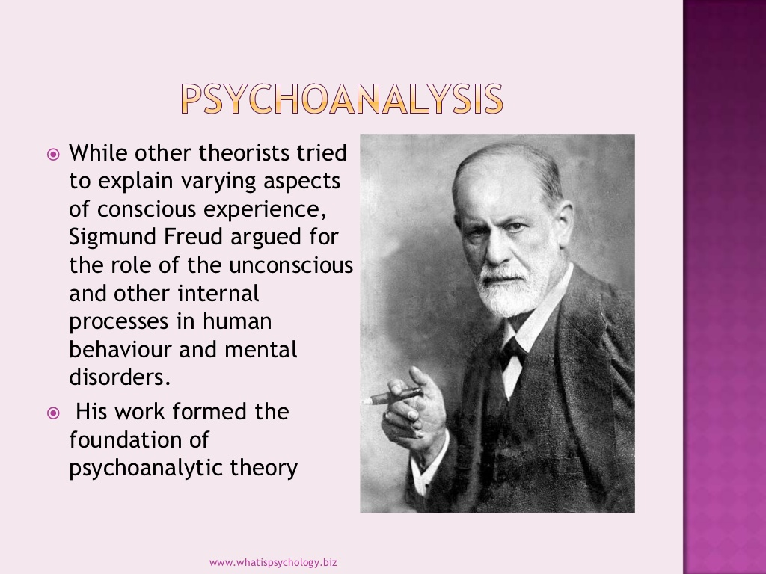

Slide 17
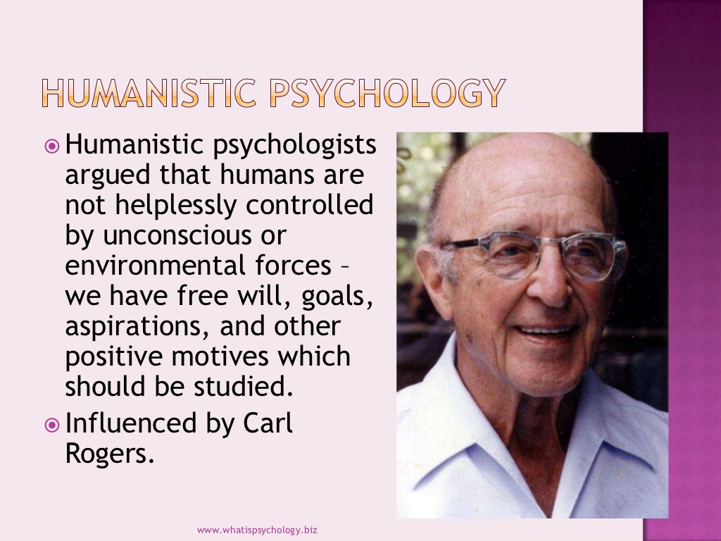

Slide 18
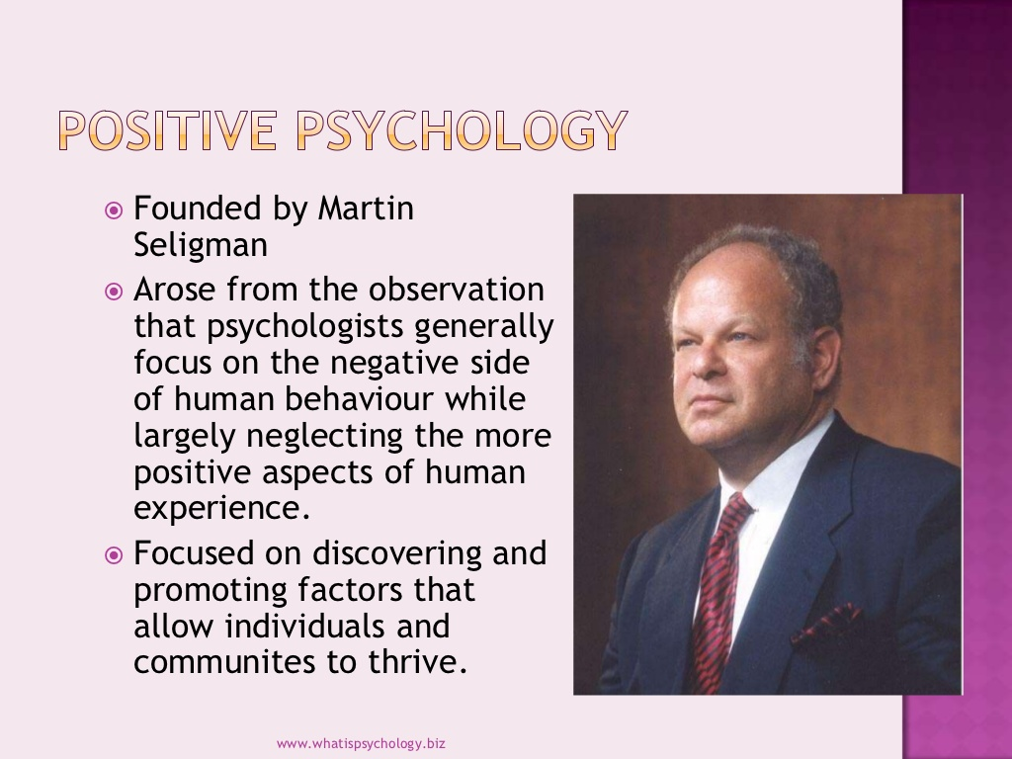

Slide 19
Cognitive psychology
Is the study of mental processes such as "attention, language use, memory, perception, problem solving, creativity, and thinking“
Much of the work derived from cognitive psychology has been integrated into various other modern disciplines such as Cognitive Science and of psychological study, including educational psychology, social psychology, personality psychology, abnormal psychology, developmental psychology, and economics

Slide 20
Evolutionary psychology
Evolutionary psychology is a theoretical approach to psychology that attempts to explain useful mental and psychological traits—such as memory, perception, or language—as adaptations, i.e., as the functional products of natural selection.

